Slide 1
Artifical intelligence and Machine Learning
Project Name:Hematovision: Advanced Blood Cell Classification Using Transfer Learning
Team Leader:D.V.S.Deepak
Team Member:A.Prasanna

Slide 2

Hematovision:
Advanced Blood Cell Classification
An AI-powered automated system for blood cell analysis, Hematovision addresses limitations of manual microscopy by leveraging Deep Learning, specifically Transfer Learning, for superior accuracy. It aims to enhance diagnostic efficiency and precision in hematology.

Slide 3
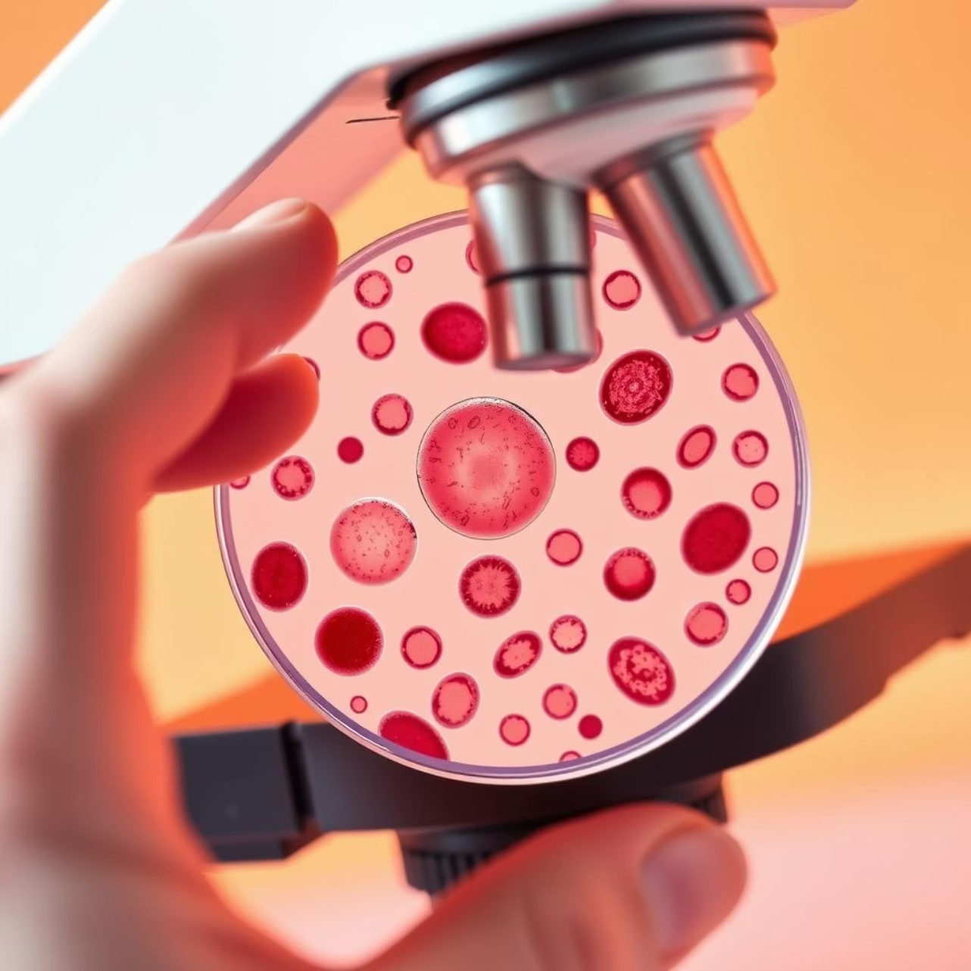
The Imperative for Advanced Classification
Blood cell analysis is critical for diagnosing infections, anemia, and leukemia. Manual differential counts are prone to human error and are time-consuming, taking 15-30 minutes per sample. Traditional methods lack consistency, with inter-observer variability up to 10-15%.
There is a pressing need for objective, rapid, and scalable solutions in clinical labs. Hematovision provides over 98% accuracy, processing results in mere seconds, transforming diagnostic efficiency.

Slide 4





Transfer Learning: The Engine of Hematovision
Concept
Re-purposing pre-trained neural networks like ImageNet models.
Models
Utilizes architectures such as ResNet-50, VGG-16, InceptionV3.
Benefits
Reduces data requirements, accelerates training time significantly.
Performance
Achieves F1-scores > 0.95 and classification accuracy > 98%.
Datasets
Validated on large public datasets like Raabin-DW and BCCD.

Slide 5
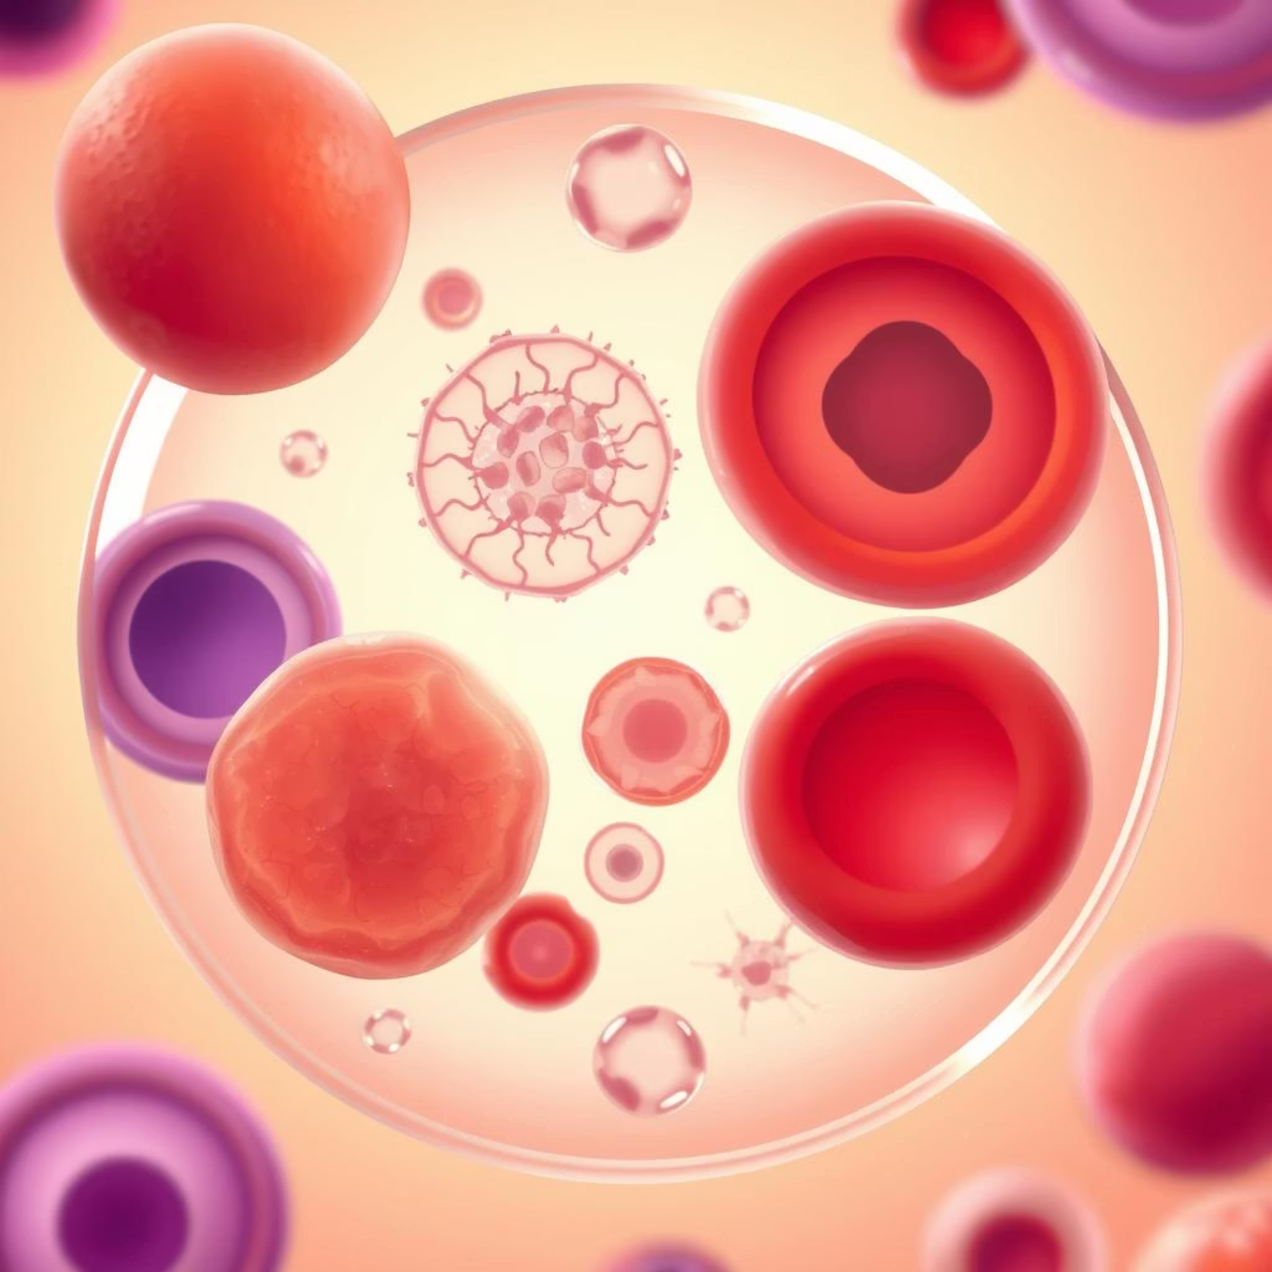
Key Blood Cell Types & Clinical Relevance
Erythrocytes (RBCs): Oxygen transport; morphology indicates anemia, thalassemias.
Leukocytes (WBCs): Immune response; crucial for infection and leukemia diagnosis.
Neutrophils: Bacterial infections, inflammation.
Lymphocytes: Viral infections, lymphocytic leukemias.
Monocytes: Chronic inflammation, some infections.
Eosinophils: Allergic reactions, parasitic infections.
Basophils: Allergic reactions, chronic myelogenous leukemia.
Thrombocytes (Platelets): Clotting; abnormalities affect bleeding/clotting.

